Slide 1
CSC-121
Introduction to
Computer Programming
Lab 0

Slide 2



Agenda
Install Anaconda
Install Sublime
Run Jupyter Notebook
Create and run code blocks
Get comfortable with Python notebooks
Run python code (.py files), from the terminal
Submit jupyter notebook + helloworld.py on Moodle
Lab Assistants:
Marissa Patel (121-01)
Abby Grant (121-02)

Slide 3
Installing Anaconda

Slide 4

1.1. Install Anaconda
Go to https://www.anaconda.com/
OR
https://www.anaconda.com/products/distribution
The Download button should match your Operating System
(and your machine specs)
Download, run and follow instructions on the installer
Installing on Windows
https://docs.anaconda.com/anaconda/install/windows/
Installing on Mac
https://docs.anaconda.com/anaconda/install/mac-os/

Slide 5
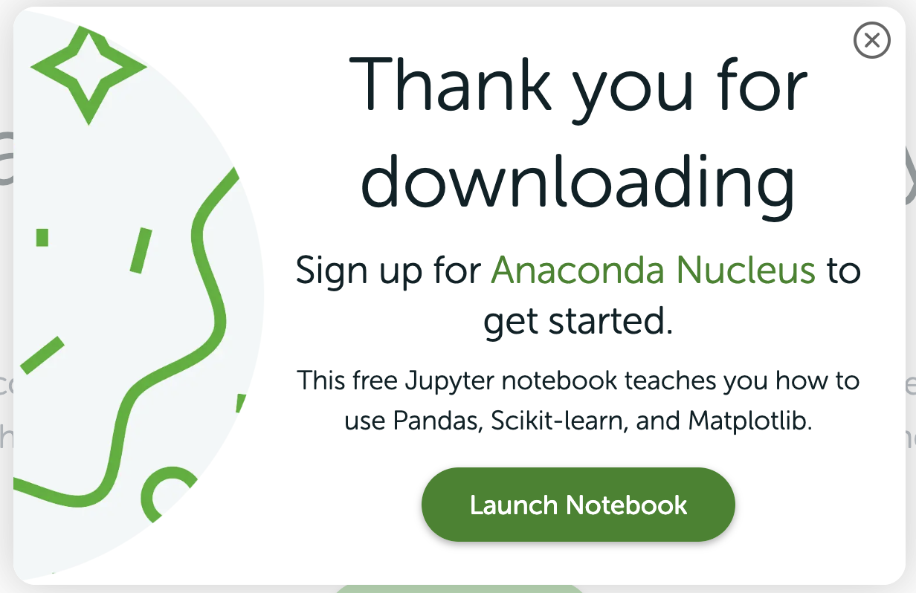
1.2. Ignore Promotional Popups
Click here

Slide 6
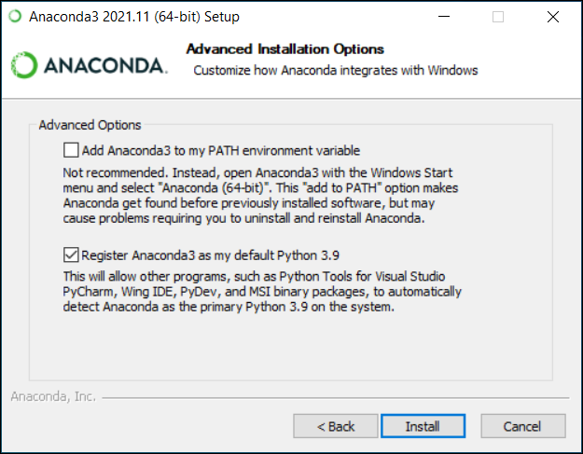
1.3. Please Add to PATH environment variable
Please check this box
If you see anything about adding to PATH environment variable, choose YES
Please pay attention to the folder path at which the installer is going to install Anaconda
On macs, this should be your home directory:
/Users/<your_name> or
/Users/<your_name>/opt/anaconda3

Slide 7
2. Running Jupyter Notebooks

Slide 8
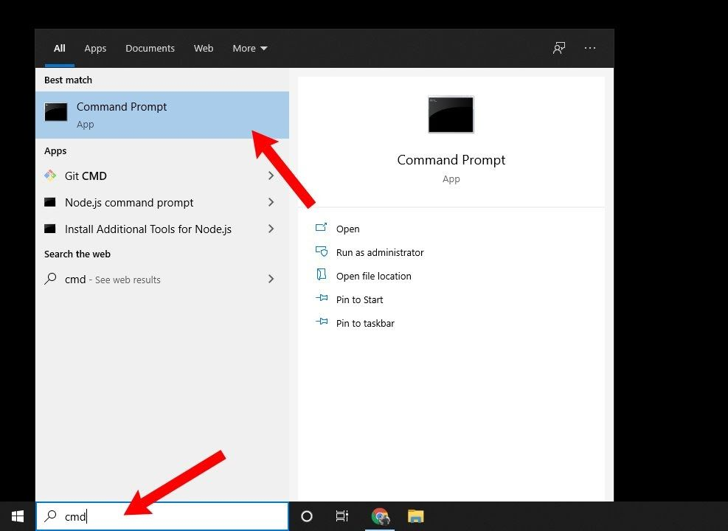
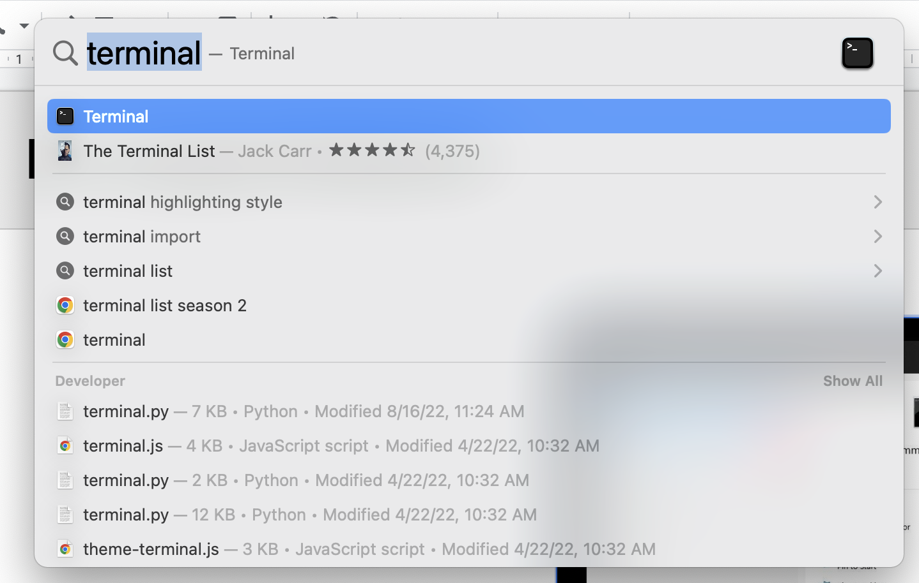
2.1. Launch Terminal/Command Prompt
Launch Terminal (Mac) / Command Prompt (Windows)
On Mac,
1. Command+Space (spotlight)
2. Type terminal and press return
MacOS
Windows

Slide 9
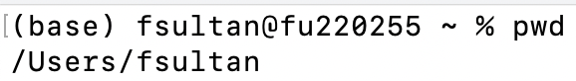
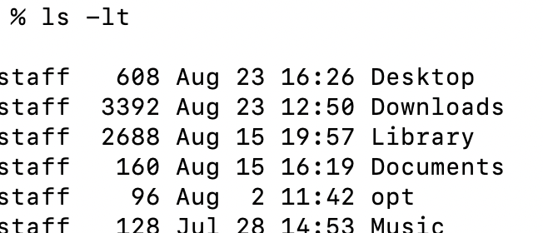
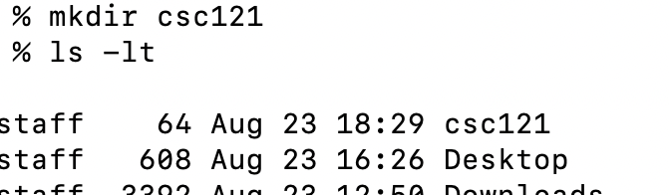
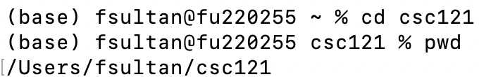
2.2. Creating a new folder, using the terminal/cmd. line
Enter the command: pwd (mac) cd (windows)
This would print the path of the current directory you are in.
Enter the command: ls -lt (mac) dir (windows)
This would print the contents of the current directory
Enter the command: mkdir csc121
This would create a new folder by the name of csc121 at your current path
Enter the command: ls -lt (mac) dir (windows)
Check if the new folder is added to the list
Enter the command: cd csc121
Enter the command: pwd (mac) cd (windows)

Slide 10
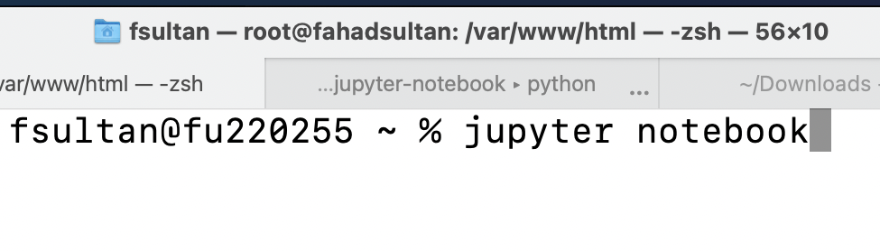
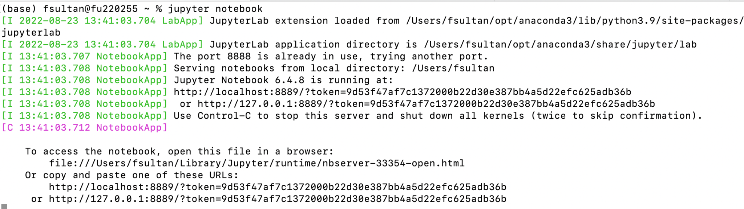
2.2. Launch Jupyter Notebook
Enter the command:
jupyter notebook
If a new tab is opened in your browser and you get something that looks like below in the terminal/command line, you are good!
If you see any errors, please see me or the lab assistant

Slide 11
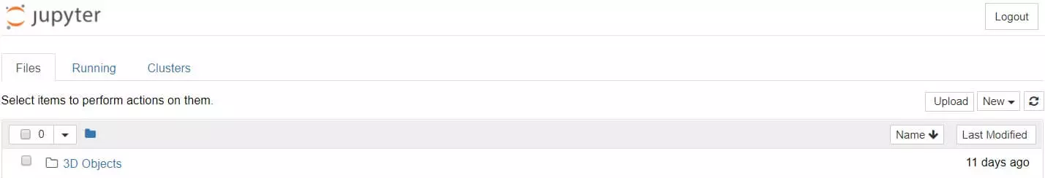
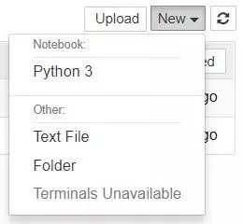
2.3. Creating a new Python Notebook
Click on “New”
Select “Python 3” from the dropdown

Slide 12
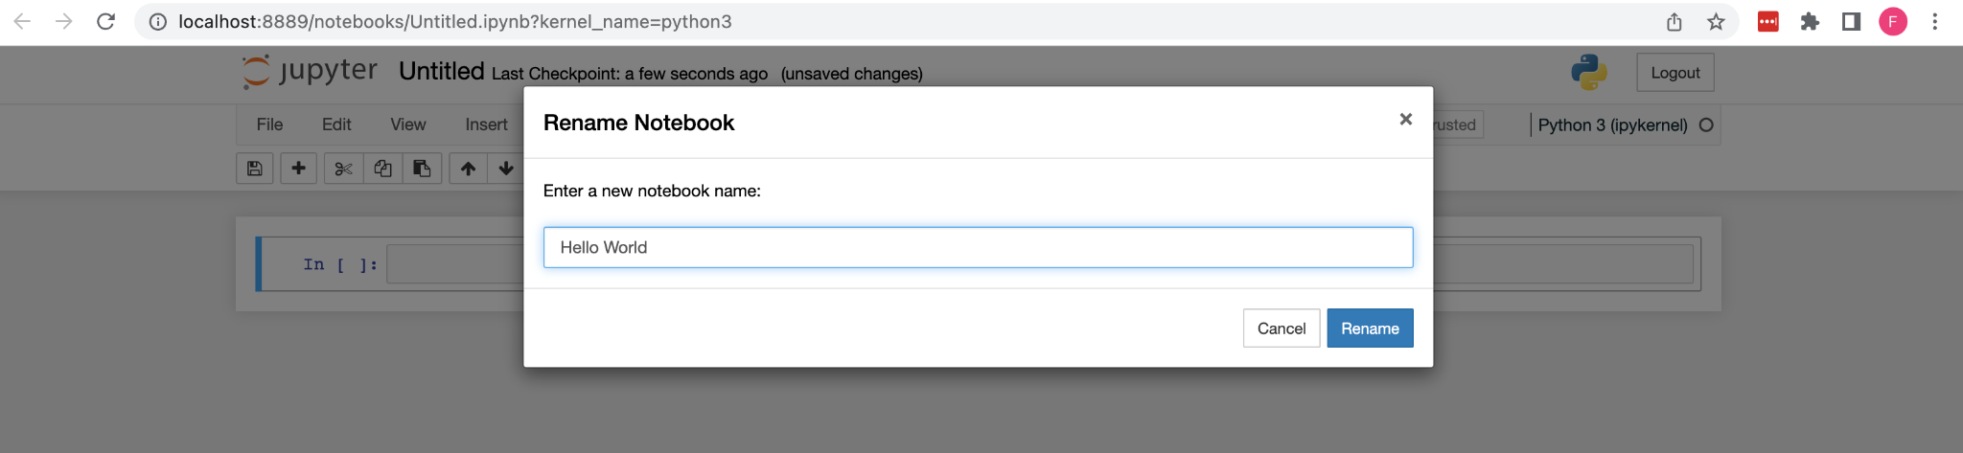
2.4. Rename Notebook
Click on Untitled on the top left, next to the Jupyter logo
Rename the file to Hello World

Slide 13
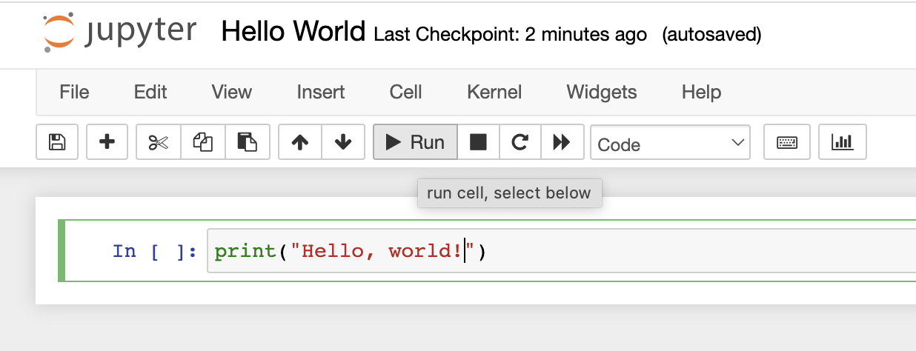
2.5. Run a code cell
In the top code cell, type print(“Hello, world!”)
Click on the “Run” button above in the toolbar

Slide 14
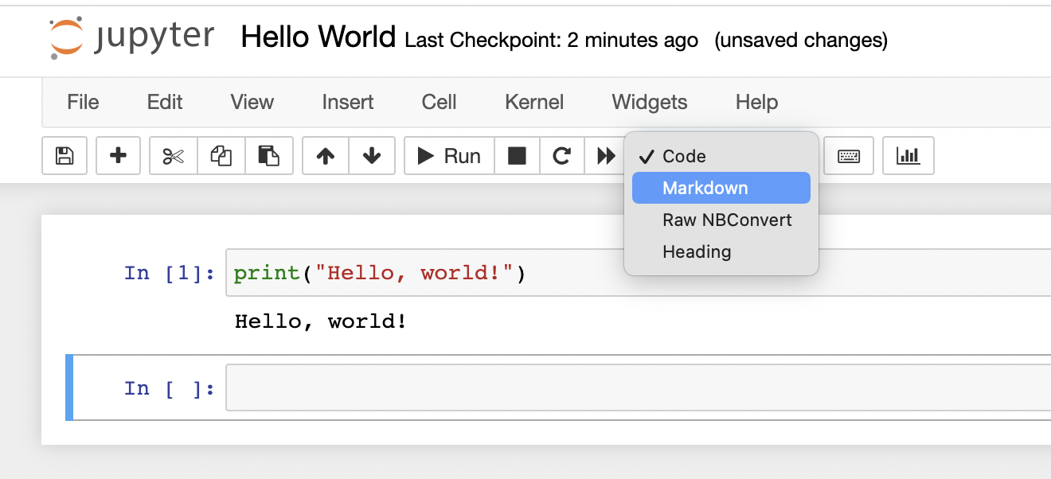
2.6. Markdown Cell
A new cell would have been created below
Click on the dropdown menu with Code preselected from the toolbar
Select Markdown from the dropdown

Slide 15
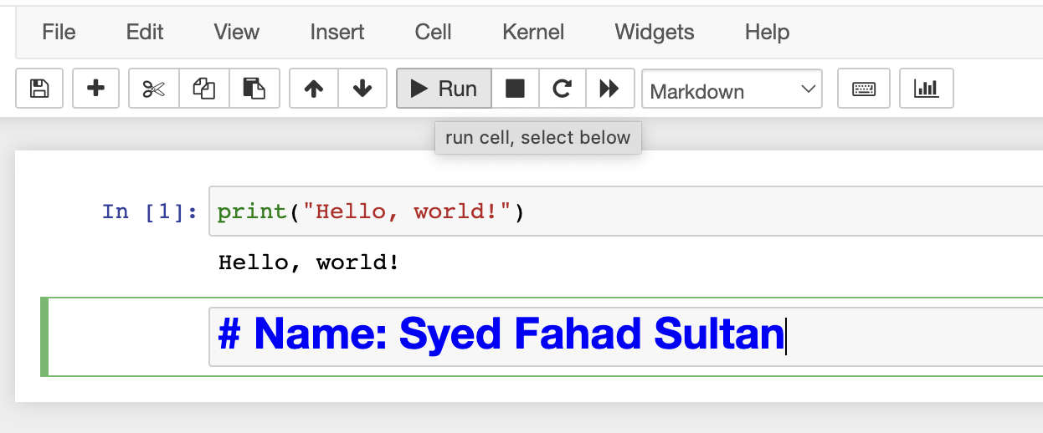
2.7. Run Markdown Cell
In the new cell, type # Name: followed by your name
Click on the Run button from the toolbar

Slide 16
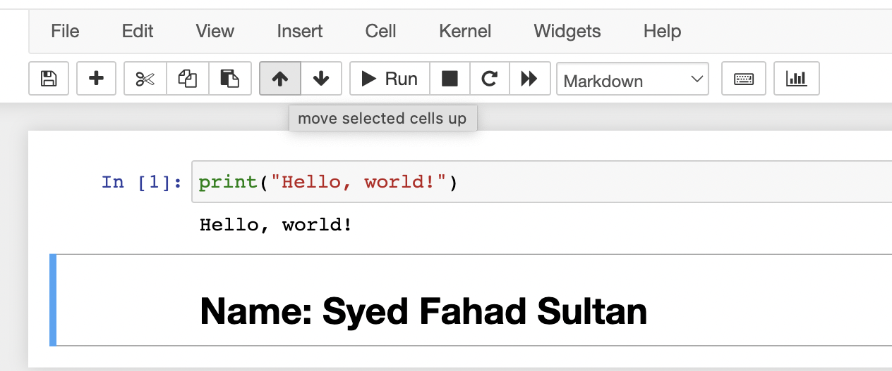
2.8. Moving cells
Click on the markdown cell
Click on the Upward Arrow in the toolbar

Slide 17
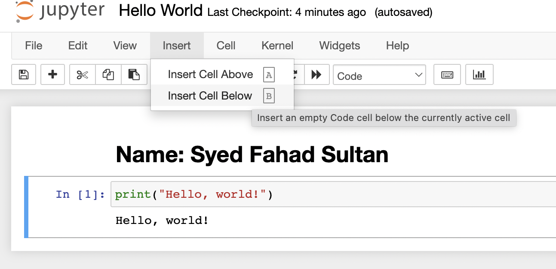
2.9. Second code cell
Click on Insert from toolbar and select Insert Cell Below from the dropdown

Slide 18
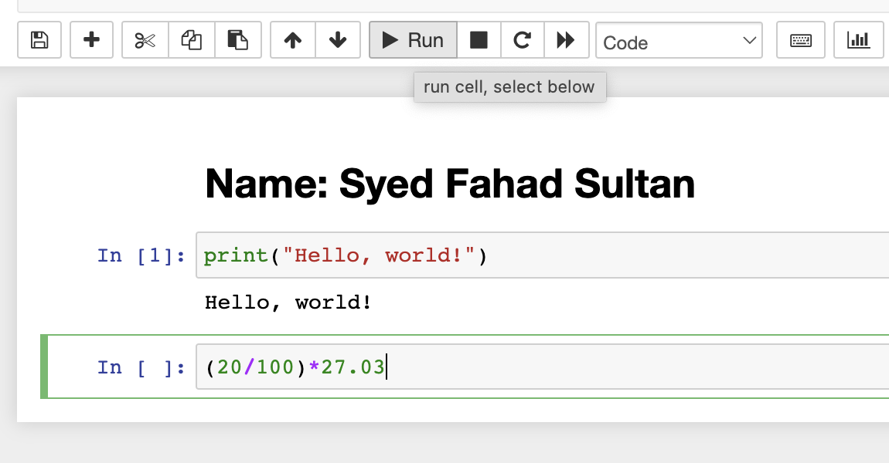
2.10. Gratuity for Check Amount: $27.03
In the newly created cell, type (20/100)*27.03
Run cell

Slide 19
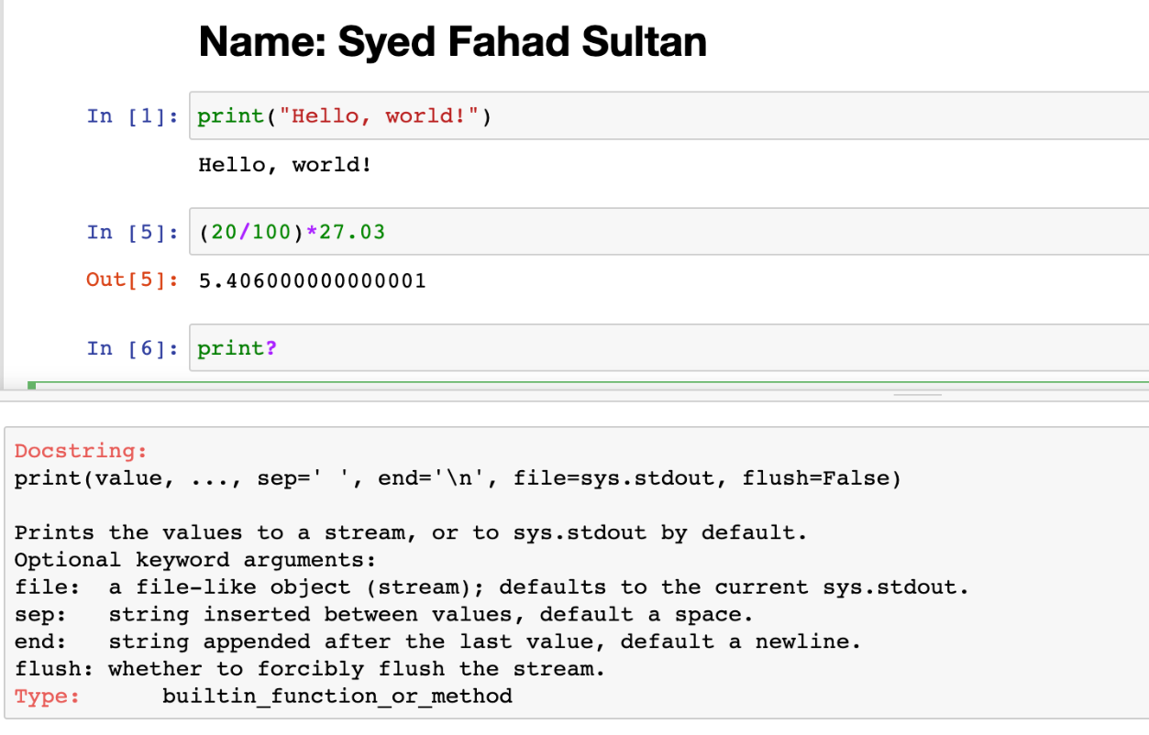
2.11. Documentation string for help
Create yet another new cell
Type print? and Run

Slide 20
3. Installing Sublime Text

Slide 21
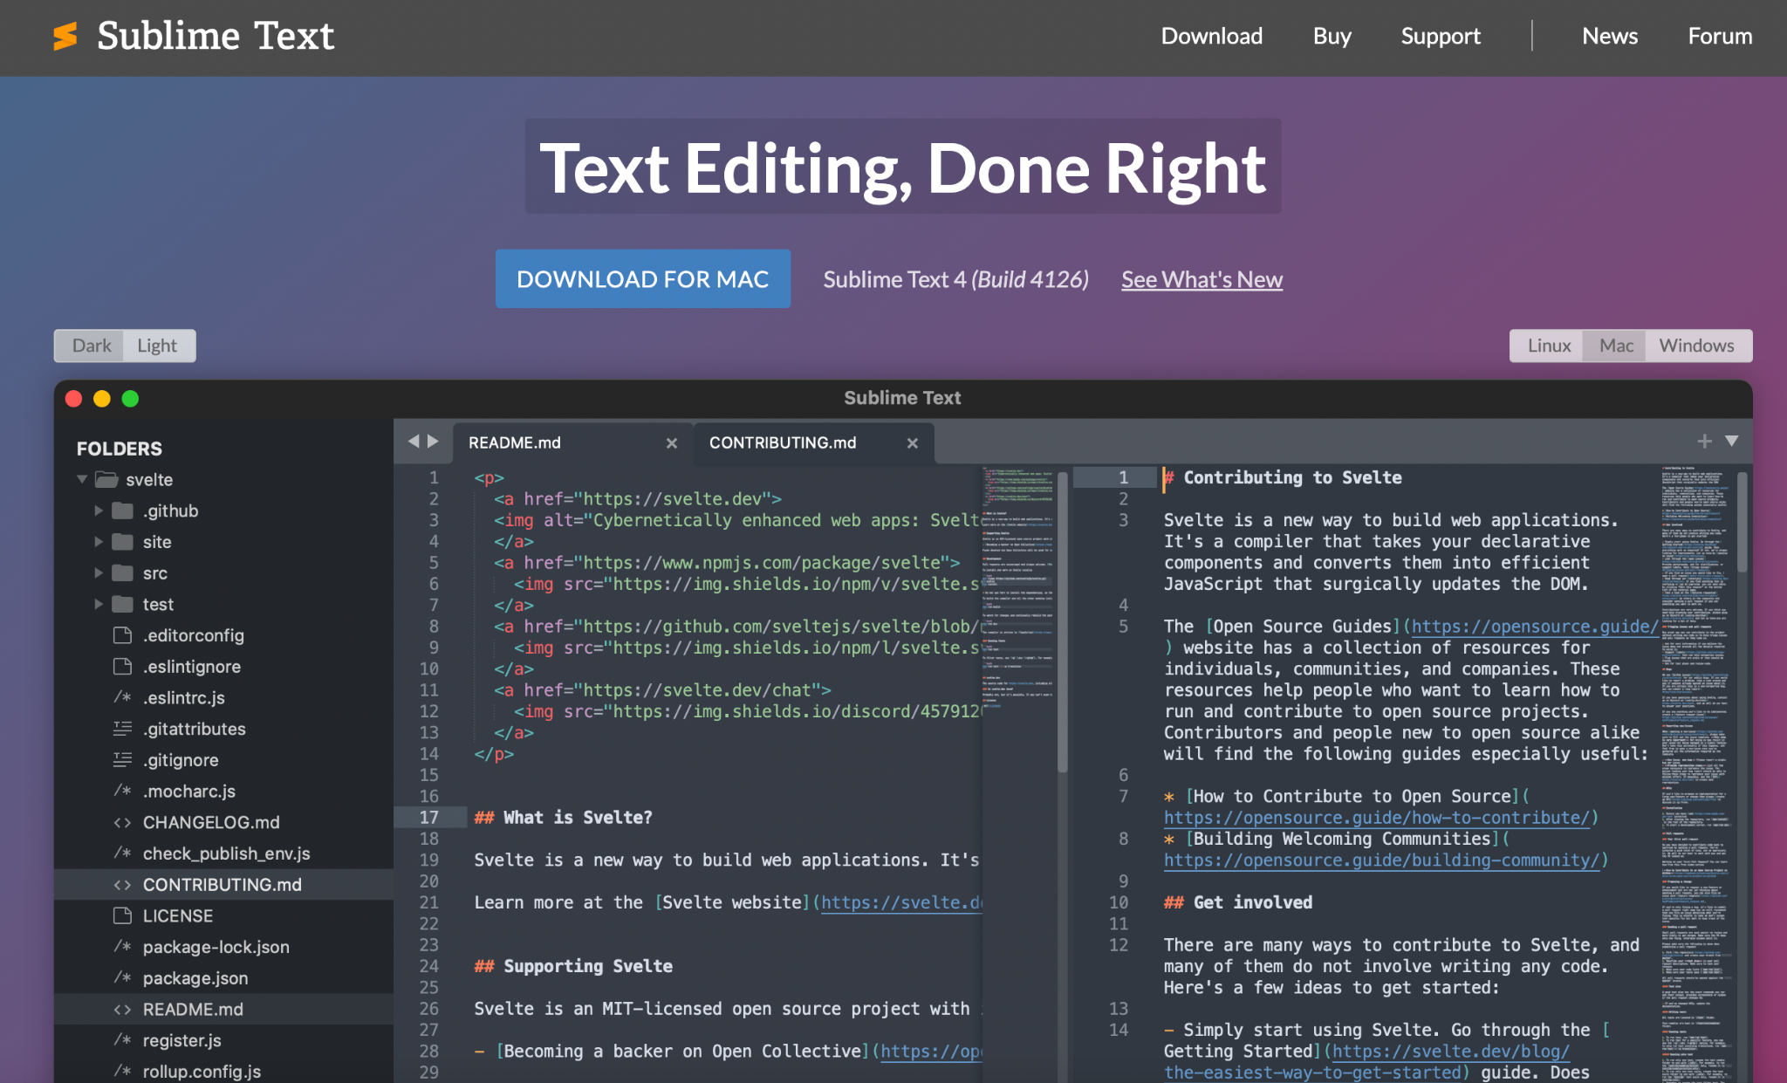
3.1. Install Sublime Text
Go to https://www.sublimetext.com/
Click on the download button
Run the downloaded file
Follow instructions to install
Run SublimeText

Slide 22
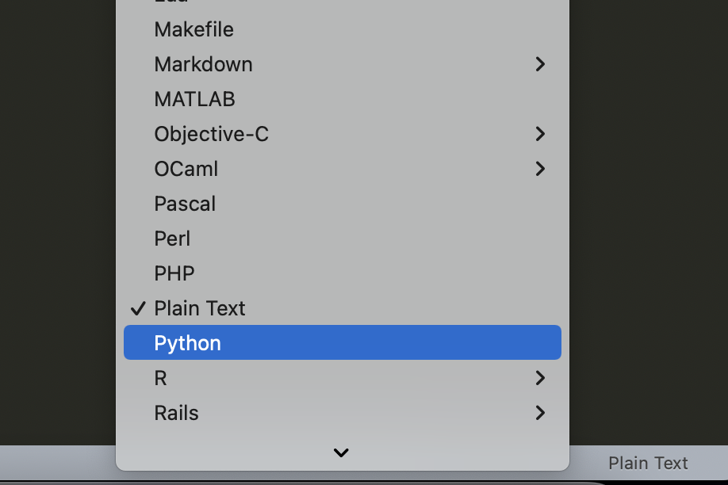
3.2. Turn on syntax highlighting
Click on Plain Text in the bottom right corner
Select Python

Slide 23
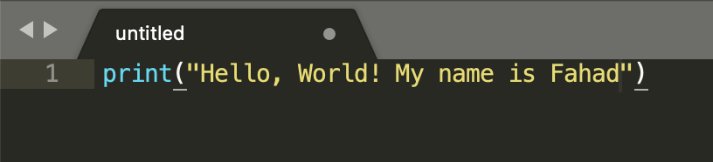
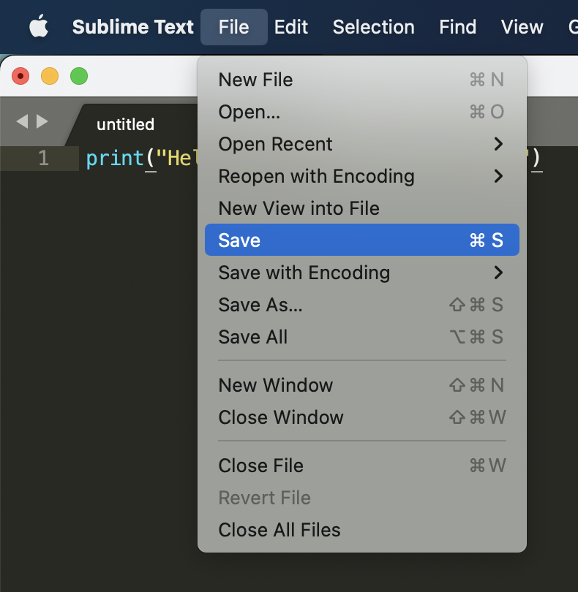
3.3. Hello World
Type in the code line shown in the screenshot
Replace Fahad with your own preferred name
Click on File, top left corner, next to Sublime Text and select Save

Slide 24
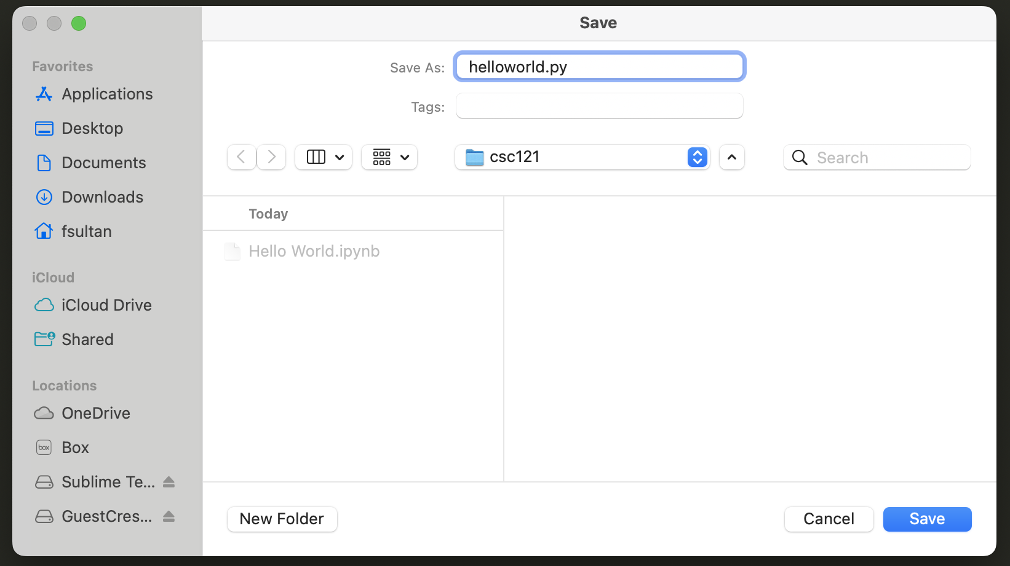
3.4. Save file
Name the file helloworld.py
Save it in the same directory as
Hello World.ipynb

Slide 25
4. Running Python code

Slide 26
4.1. Launch Terminal/Command Prompt
Launch Terminal (Mac) / Command Prompt (Windows)
On Mac,
1. Command+Space (spotlight)
2. Type terminal and press return
MacOS
Windows

Slide 27
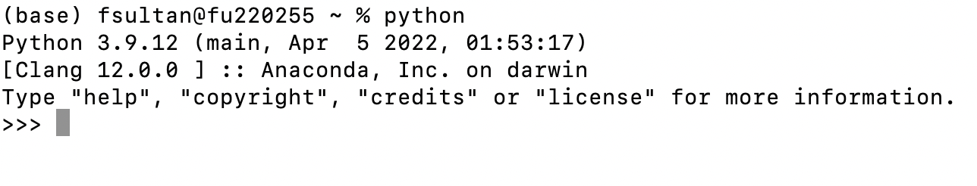
4.2. Testing Python
Enter the command:
python
If you see the three greater than signs >>> you are good
Enter the python code: print(“Hello, world!”)
Enter exit()

Slide 28
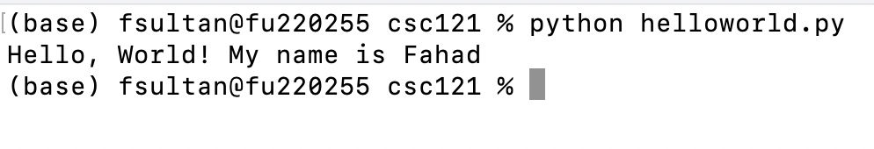
4.3. Run helloworld.py
Use cd (perhaps multiple times) to go to the directory where you saved helloworld.py
Use ls -lt (mac) or dir (windows) to confirm
Run the command:
python helloworld.py

Slide 29
5. Submission to Moodle

Slide 30
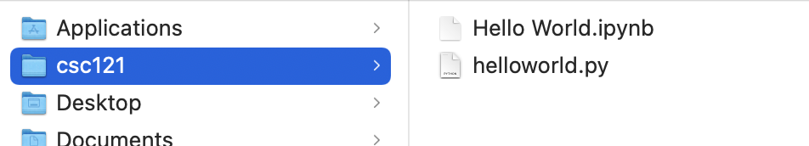
5.1. Confirm folder content
Make sure your Hello World.ipynb and helloworld.py files are both in the same folder

Slide 31
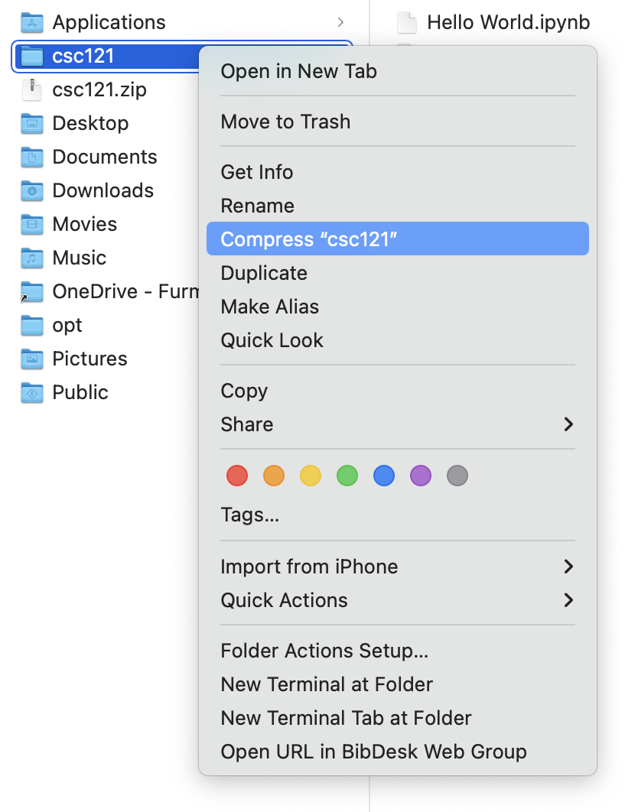
5.2. Compress folder
Right Click on folder
Select Compress

Slide 32
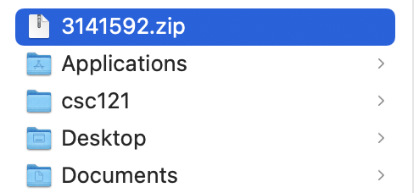
5.3. Rename compressed folder to Student ID & Submit
Rename compressed folder to your Student ID
Submit on Moodle, under “Lab 0”

